Slide 1
Memory Management
Part 3
Memory Management Strategies
Virtual Memory Management

Slide 2

Swapping
System maintains a ready queue of all processes whose memory images are either in memory or backing store and are ready to run
Dispatcher checks the presence of the next process in memory and acts accordingly
Swap in and swap out results in a high context-switch time
Major part of the swap time is the transfer time
Total transfer time is proportional to the amount of memory swapped
Swap only that part of the memory which is being used by the process
User must keep the system informed of any changes in the memory requirements

Slide 3
Swapping
A process selected for swapping should be completely idle
A process waiting on I/O can not be swapped
I/O is accessing user buffers asynchronously
Solutions
Never swap a process with pending I/O
Execute I/O operations only into OS buffers
Standard swapping is not used in modern OS
Modified versions of swapping are found in many systems
Used in many versions of UNIX
Swapping is enabled when the available free memory falls below a threshold

Slide 4
Swapping on Mobile Systems
Mobile systems do not support swapping
Space constraint – Use flash memory for storage
Flash memory can tolerate only limited number of writes
Poor throughput between main memory and these devices
Free memory space?
Apple iOS asks applications to relinquish voluntarily allocated memory
May also terminate a program
Android also uses similar strategy

Slide 5
Contiguous Memory Allocation
A method of allocating memory to OS and user processes
Memory is divided into two partitions
Resident operating system
User processes
OS is generally kept in the lower memory
Available memory is allocated to the processes through contiguous memory allocation
Memory Protection
Protection among processes can be provided through a relocation register and a limit register
Relocation register contains the smallest physical address
Limit register contains the range of logical addresses

Slide 6
Contiguous Memory Allocation
MMU maps the logical address dynamically
Mapped address is sent to memory
Dispatcher loads the relocation and limit registers with the correct address as part of context-switch
Protection of processes from each other
This scheme provides an effective way to change the OS size dynamically
A desirable flexibility
Transient OS code
It is loaded into memory when needed and may be removed in case of other memory requirements

Slide 7
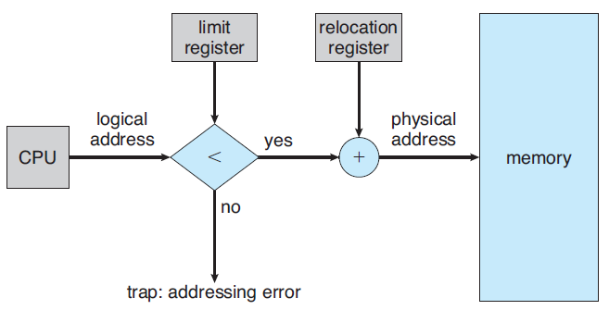
Hardware Support for Relocation and Limit Registers
Notes:
7

Slide 8
Memory Allocation
Simplest method to allocate memory is to divide the memory into several fixed-size partitions
Each partition contains one process
Degree of multiprogramming is bound by the number of partitions
When a partition is free, a new process is selected to be loaded into memory
MFT used in IBM OS/360
MVT is a generalization of the above scheme
In variable partitioning scheme, OS maintains a table of free memory spaces (called holes) and memory spaces that are occupied
An arriving process is allocated a part/full hole according to its memory needs
At any time, there is a list of available block sizes and a ready queue
Notes:
Multiprogramming with a fixed number of tasks and multiprogramming with a variable number of tasks MFT and MVT

Slide 9
Memory Allocation
Allocation is done to processes till the partitions are available
Set of holes of variable sizes are scattered throughout the memory
System needs to match the need and availability
Dynamic storage allocation problem
How to satisfy a request of size n from a list of free holes?
Solutions
First fit:
Allocate the first hole that is big enough
Search can start from the beginning or where the last search ended

Slide 10
Memory Allocation
Best fit:
Allocate the smallest hole that is big enough
Search the entire list unless sorted by size
Produces the smallest leftover hole
Worst fit:
Allocate the largest hole
Produces the largest leftover hole
Search the entire list unless it is sorted by size
Simulation results
First and best fit are better than worst fit in terms of decreasing time and storage utilization
First fit is generally faster than best fit

Slide 11
Fragmentation
Both first bit and best fit strategies suffer from external fragmentation
Free memory space is broken into small pieces
External fragmentation exists when there is enough total memory space to satisfy a request but the available spaces are not contiguous
Storage is fragmented into a large number of small holes
Depending on the total memory space and the average process size
External fragmentation may be a minor or major problem
First fit has shown to suffer from the property of 50 percent rule

Slide 12
Fragmentation
50-percent rule
Given N allocated blocks, 0.5 N blocks are lost to fragmentation
One-third of the memory may be unusable
Memory fragmentation can be internal or external
Internal fragmentation
Memory is generally divided into fixed size blocks and allocated to processes in multiples of fixed size blocks
Allocated memory may be larger than the requested size
Difference results in unused memory lost to internal fragmentation

Slide 13
Fragmentation
Compaction is a solution to external fragmentation
Shuffle free memory spaces to form one large contiguous block
Possible only if relocation is dynamic and is done at run time
Compaction algorithms
Another solution to external fragmentation
Permit the physical address space of the processes to be noncontiguous
Two techniques are used to achieve this
Paging
Segmentation
The two techniques can also be combined

Slide 14
Segmentation
A programmer’s view of memory is a collection of variable sized segments
Each segment has a name and a length
Each address is specified by the programmer in two parts
A segment and an offset within the segment
A simplified scheme may use segment numbers
A logical address: segment number, offset
A C compiler creates separate segments for:
A code segment
Global variables
A heap
A stack
The standard C library

Slide 15
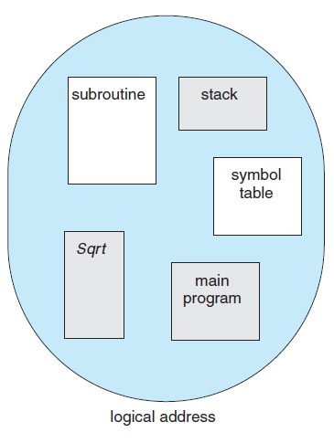
Programmer’s View of a Program
Notes:
15

Slide 16
Segmentation Hardware
Two dimensional logical address needs to be mapped to a one-dimensional physical address
This mapping is performed through a segment table
Segment table
Each entry has a segment base and a segment limit
Segment base
Starting physical address of the segment in memory
Limit specifies the length of the segment
Segment number s is used to index to the table
Offset d is between 0 and the segment limit
An example segmentation having a number of segments

Slide 17
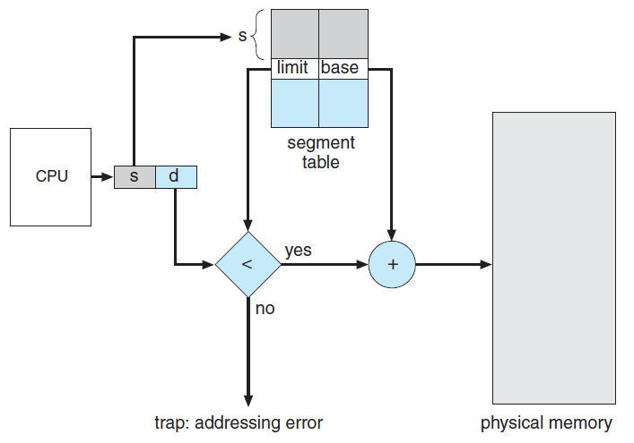
Segmentation Hardware
Notes:
17

Slide 18
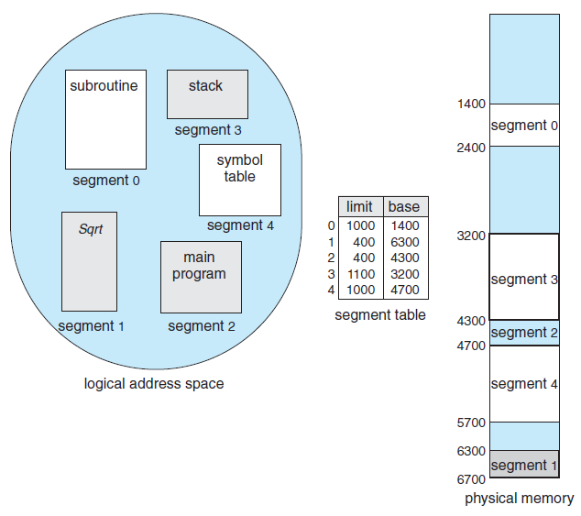
Example of Segmentation
A number of example addresses
3:100, 1:900, 4:2000, 2:399
Notes:
18

Slide 19
Paging
Another memory management scheme that permits the physical address space of a process to be noncontiguous
Avoids external fragmentation and compaction
Most operating systems use paging
Basic Method
Physical memory is partitioned into fixed- sized blocks – frames
Logical memory is also partitioned into the same fixed-sized blocks – pages
When a process is to be executed
Pages are loaded from the backing store into the available memory frames
Backing store is also partitioned into fixed-sized blocks of the same size

Slide 20
Basic Method of Paging
Hardware support for paging
Every address is divided into two parts
Page number is used as an index into the page table
Page table contains the base address of each page in physical memory
The paging model of memory
Page size is defined by the hardware
Typically a power of 2
Varies between 512 bytes to 1GBbytes
If the size of logical address space is 2^{m} and page size is 2^{n}
The higher order (m – n) bits designate the page number
The lower n bits designate the page offset

Slide 21
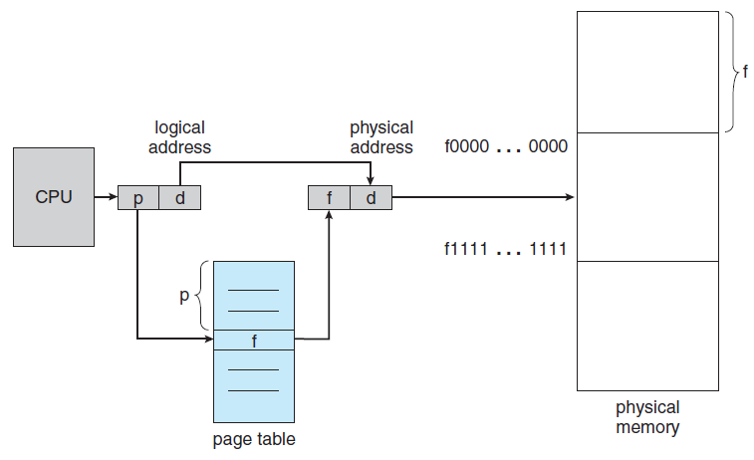
Paging Hardware
Notes:
21

Slide 22
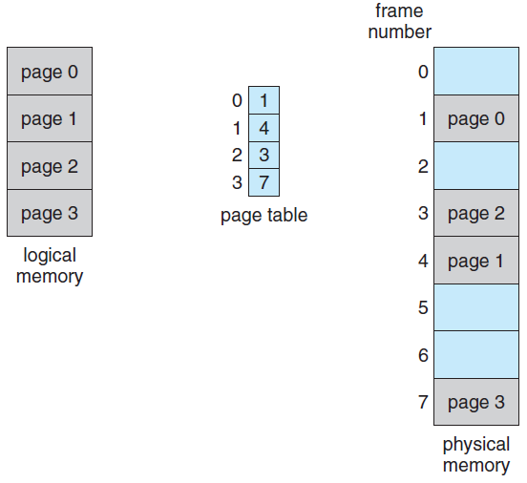
Paging Model of Logical and Physical Memory
m – n
n
Notes:
22

Slide 23
Basic Method of Paging
page number
page offset
p
d
m - n
n
p is the index to the page table and d is the displacement within the page
Paging is a form of dynamic relocation
There is no external fragmentation in paging
There may be internal fragmentation
Last allocated frame may not be completely full
Average internal fragmentation is half page per process
Small page sizes are desirable
Overhead of page table increases with small page sizes
Disk I/O is more efficient with large page sizes

Slide 24
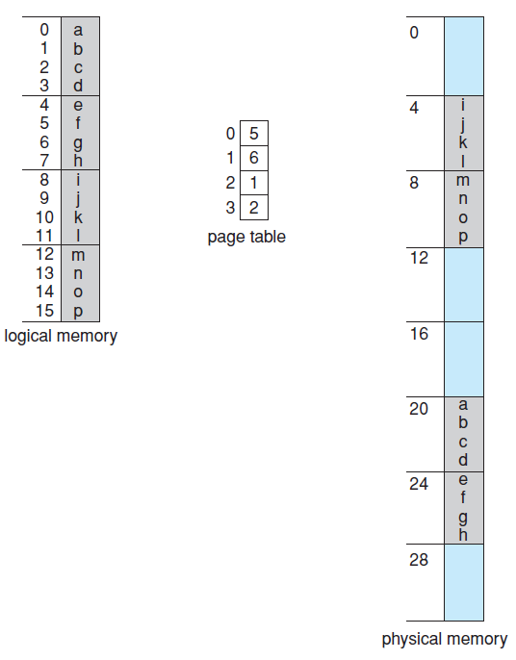
Paging Example
32-byte memory and 4 byte pages
Logical addresses
0
3
4
Notes:
24
128 byes memory and 8 byte pages
4GBytes memory with4KB pages

Slide 25
Basic Method of Paging
Page sizes have increased with the increase in processor performance
4KB and 8 KB sized pages
Some CPUs and kernels support multiple page sizes
Solaris uses 8 KB and 4 MB pages
Each page table entry is 4 bytes long
Frames are allocated to processes as required
There is a clear separation between user’s view of memory and the actual physical memory
The difference between the two is reconciled by the address-translation hardware
Logical addresses are translated into physical addresses

Slide 26
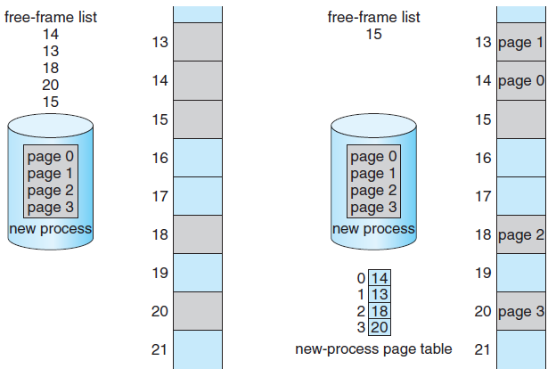
Free Frames before and after allocation
Before allocation
After allocation
Notes:
26

Slide 27
Basic Method of Paging
Mapping is hidden from the user and is controlled by the OS
OS maintains a frame table of all frames that has one entry for each physical page frame
Both allocated and unallocated frames
It also maintains a copy of the page table for each process
This is used by the dispatcher to define the hardware page table when a process is to be allocated to the CPU
Paging increases the context-switching time

Slide 28
Hardware Support
Most OS allocate a page table to each process
Pointer to the page table is stored in the process control block of that process
Hardware implementation of page table
Simplest case
Page table is implemented as a set of dedicated registers
The registers should be built with high speed logic circuits to achieve fast address translation
These registers are reloaded by the dispatcher as a part of context-switch time
Feasible if the page table is reasonably small
Current generation computers support very large page table
Notes:
DEC PDP=11 has 8 registers to hold the page table

Slide 29
Hardware Support
Page table is kept in main memory
PTBR (Page Table Base Register) points to the page table of the process
Changing page table requires changing only the content of PTBR
Context switch time is reduced
Problem
Time required to access a memory location increases
Two memory accesses are required for every desired access to memory
Solution
Use a special, small, fast lookup hardware cache
Translation look-aside buffer (TLB)

Slide 30
Hardware Support
TLB
An associative, high-speed memory
Each entry of TLB consists of two parts
A key (or tag) and a value
The search process in the TLB
This is a fast operation but the hardware is expensive
Number of entries in the TLB is small
Typically between 64 and 1024 entries
Working of the TLB
TLB miss and TLB hit
In case of TLB miss, page table should be accessed

Slide 31
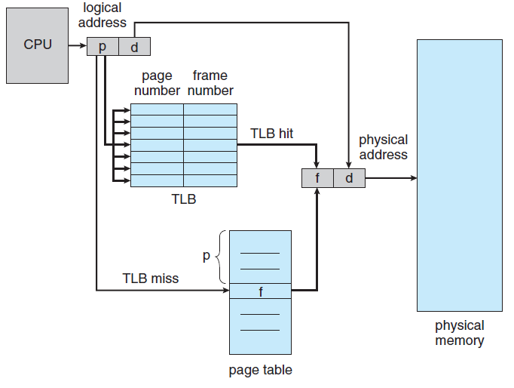
Paging Hardware With TLB
Notes:
31

Slide 32
Hardware Support
If the TLB is full, an entry should be selected for replacement
Replacement policies range from Least Recently Used (LRU) to random
Some TLBs allow entries to be wired down
These entries cannot be removed from the TLB
Kernel code
Some TLBs store Address Space Identifiers (ASIDs) in each TLB entry
An ASID uniquely identifies each process and provides address-space protection for that process
Allows TLB to contain entries for several processes simultaneously
TLB must be flushed otherwise

Slide 33
Hardware Support
Hit ratio
Percentage of times that a particular page number is found in the TLB
Calculate the effective memory access-time with TLB hit ratio of 80%, 40% and 98%
Time to search the TLB = 20 nanoseconds
Time to access memory = 100 nSec
Overall memory access time reduces with the increase in the hit ratio
Current generation processors have multiple levels of TLB
Core i7 CPU has two levels of TLB
TLB is a hardware feature that is not visible to the user and the OS
Notes:
Effective memory access time

Slide 34
Protection
Protection bits for each page frame is stored in the page table
All accesses to memory require access to page table with illegal accesses causing trap to the OS
Read-only, read-write, execute-only
Valid-invalid bit is used to indicate whether a page is in the address space of a particular process
Processes use only a fraction of the total address space available to them
Most of the page table is unused
Provide hardware support to avoid memory wastage
Page table length register (PTLR) is used to indicate the size of the page table
Notes:
128entry L1 insruction and a 64 entry L1data TLB -1st level
512 entry L2TLB

Slide 35
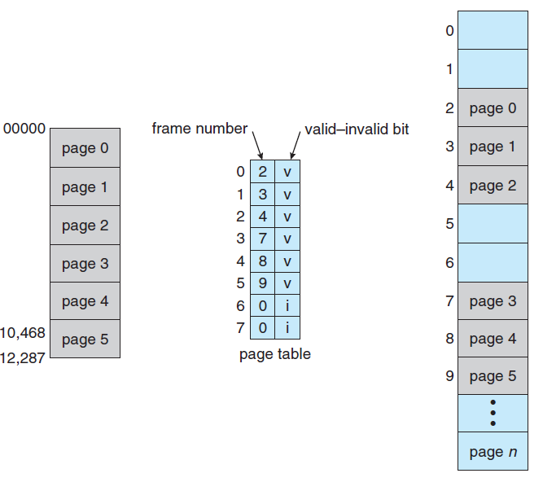
Valid (v) or Invalid (i) bit in a Page Table
Notes:
35

Slide 36
Shared Pages
An advantage of paging is sharing of common code
The reentrant code that are used by a large number of users can be placed in shared pages to save memory
Reentrant code
Non-self-modifying code that does not change during execution
Data will be unique for each of the processes that is running the code
Text editors, compilers, run-time libraries, database systems, etc. are the applications that can be used for sharing
The code needs to be read-only

Slide 37
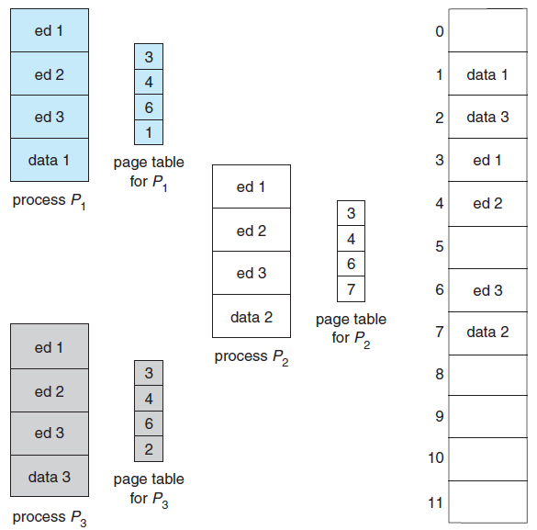
Shared Pages Example
Notes:
37

Slide 38
Structure of the Page Table
Hierarchical Paging
A large logical address space results in a large page table
Page table may need up to 4MB of physical address space for 32-bit logical address space
Solution
Divide the page table into smaller pieces
Ways to implement the division into pages
Use a two-level paging algorithm
Page table is itself paged
Bits distribution for logical address would change
Address translation method would also change
Forward-mapped page table
Notes:
VAX supports a variant of two-level paging scheme

Slide 39
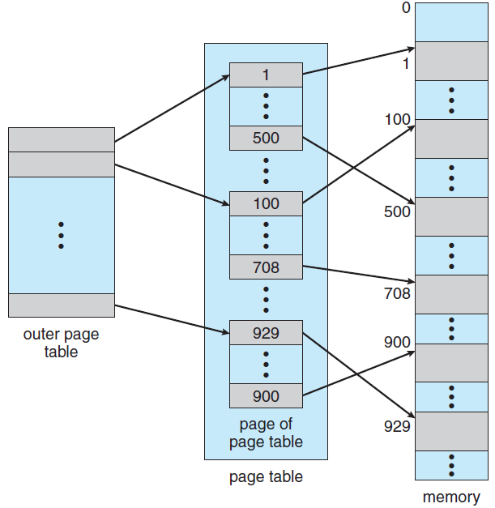

Two-Level Page-Table Scheme
10
10
12
Notes:
39

Slide 40
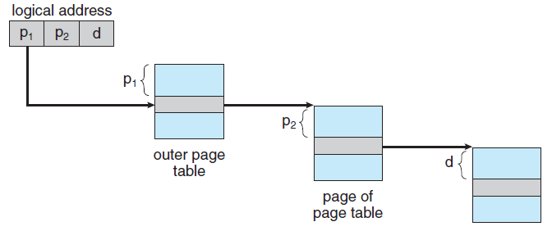
Address-Translation Scheme for a two-level 32-bit paging architecture
Notes:
40

Slide 41
Hierarchical Paging
For a large address space, two-level paging scheme is no longer appropriate
For example, a 64-bit logical-address space
Solution
Divide the outer page table into smaller pieces
The approach is used in 32-bit processors too
Outer page table can be divided in a number of ways
Three-level paging scheme
Next step is a four-level paging scheme
Problem
Multilevel paging scheme requires a large number of memory accesses to translate an address

Slide 42


Three-level Paging Scheme
Notes:
42

